Slide 1
Coffee Shop Sales Performance
&
Transaction Analytics
Presented by: Sabari B
Course : Data Analytics

Slide 2
Business Problem
The coffee shop generated $698,780.73 in revenue from January to June 2023.
Monthly revenue varied, with February recording the lowest revenue of $76,145.19.
June recorded the highest monthly revenue of $166,485.88.
Management needs to understand how transaction volume and quantity sold relate to monthly revenue changes.
This project analyzes monthly sales trends, store performance, and product performance to support better business decisions.

Slide 3
Dataset Overview
Dataset: Coffee Shop Sales
Source: Kaggle — Ahmed Mohamed's Coffee Shop Sales dataset
Period: January – June 2023
Original Records: 1,50,765
Records After Cleaning: 1,49,110
Original Columns: 11
Tool Used: Microsoft Excel

Slide 4
Data Cleaning & Transformation
Data Inspection: Checked the dataset structure and column names.
Missing Values: Checked for missing data.
Duplicate Removal: Removed 1,655 duplicate records.
Data Type Conversion: Corrected the data types of relevant columns.
Invalid Value Checking: Checked for incorrect or invalid values.
Text Standardization: Corrected inconsistent text, including “lower manhattan” and “cofee.”

Slide 5
Excel Formulas & Analysis
SUM: Calculated the total sales revenue.
SUMIF: Calculated totals based on a single condition. Used for store-wise Revenue.
SUMIFS: Calculated totals based on multiple conditions. Used for Revenue Level column.
AVERAGE: Calculated the average revenue value.
COUNTIF: Counted records that matched a specific condition.
Revenue Calculation: Quantity × Unit Price.

Slide 6
Pivot Analysis
Created PivotTables to summarize sales data.
Analyzed revenue by store location.
Compared revenue across product categories.
Analyzed quantity sold by product type.
Examined monthly revenue trends.
Used PivotTables to create PivotCharts and the dashboard.

Slide 7
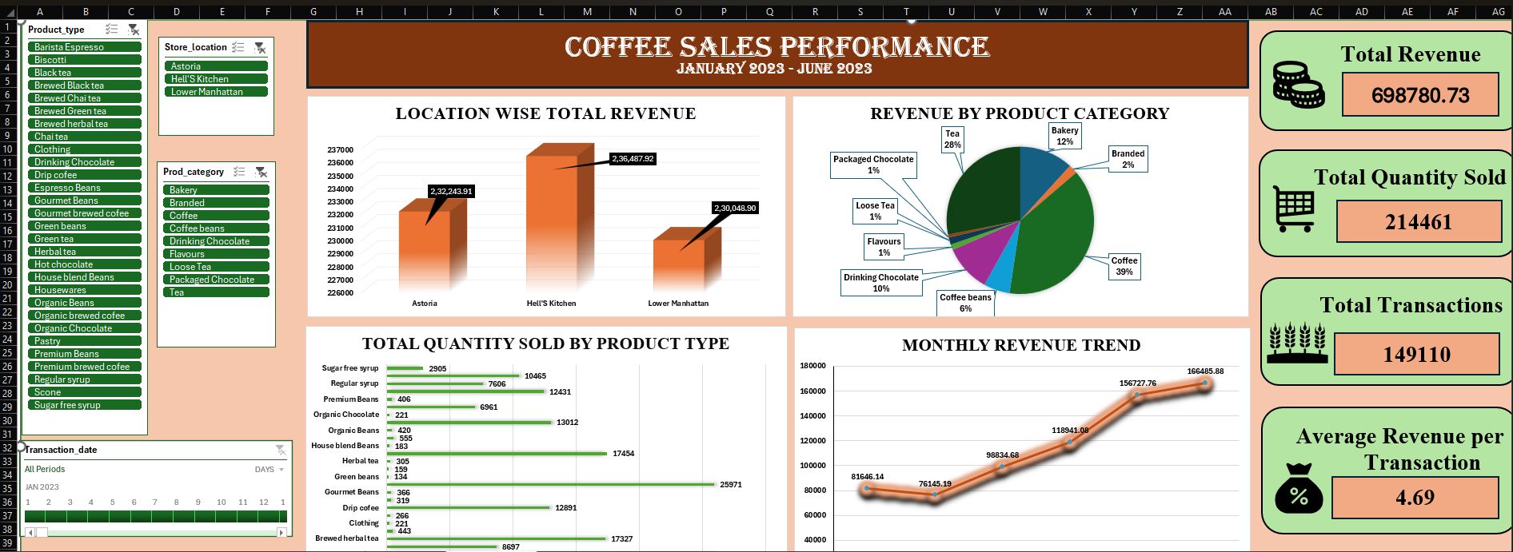
Dashboard

Slide 8
Key Insights & Recommendations
Key insights
Monthly Revenue: February recorded the lowest revenue of $76,145.19, while June recorded the highest at $166,485.88.
Revenue Growth: Revenue increased by 31.77% from April to May.
Store Performance: Hell's Kitchen generated the highest revenue of $236,487.92.
Category Performance: Coffee generated $269,945.45, contributing approximately 38.6% of total revenue.
Product Demand: Brewed Chai Tea recorded the highest product-type quantity sold, with 26,248 units.

Slide 9
Business recommendations
Investigate Sales Decline: Compare February sales across stores and product categories to identify where performance was lower.
Study Sales Growth: Examine the April-to-May sales breakdown to understand which products and stores contributed most to the increase.
Plan Product Stock: Use historical sales quantities to plan stock levels for popular products and reduce the risk of stock shortages.
Improve Product Planning: Review sales performance across product categories to identify opportunities for improvement.
Track Future Performance: Set monthly sales targets and compare actual results against them.

Slide 10
Conclusion
The analysis provides a clear understanding of the coffee shop's overall sales performance.
Sales data helps management understand business performance across different areas.
Comparing sales patterns helps identify changes that require further investigation.
Historical sales information provides a useful basis for evaluating future business performance.
The findings support more informed business decisions using actual sales data.

Slide 11
THANK YOU

